Slide 1
User Datagram
Protocol
(UDP)

Slide 2
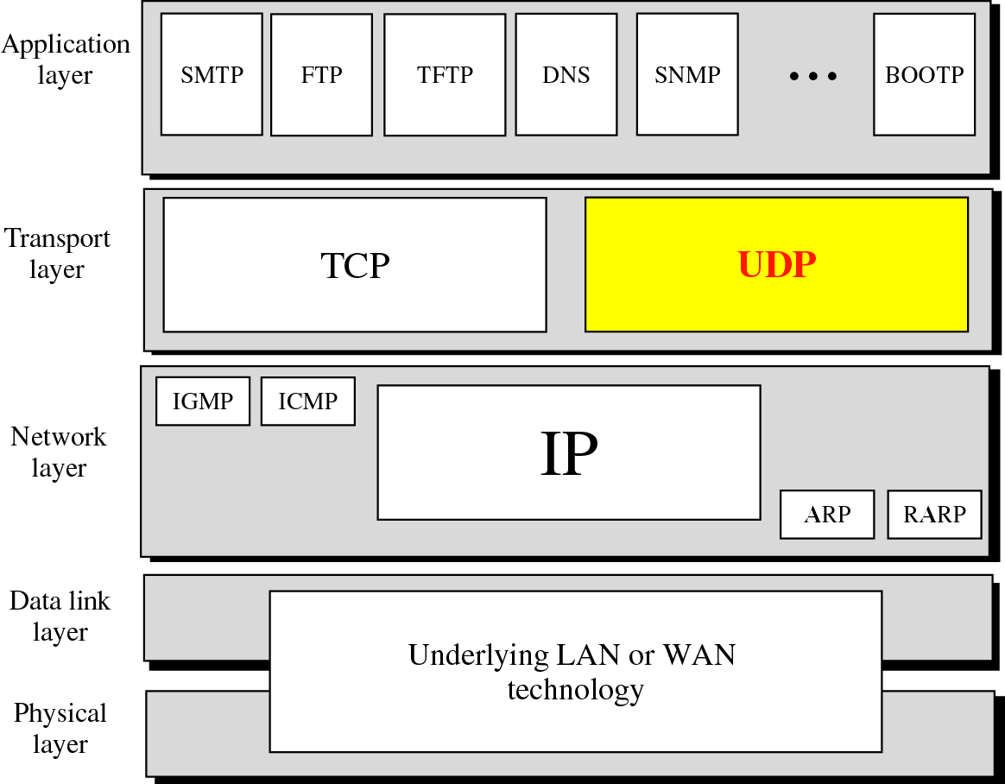
Position of UDP in the TCP/IP protocol suite

Slide 3
Role of Transport Layer
process-to-process communication (uses port numbers)
flow control
reliable transmission
error control

Slide 4
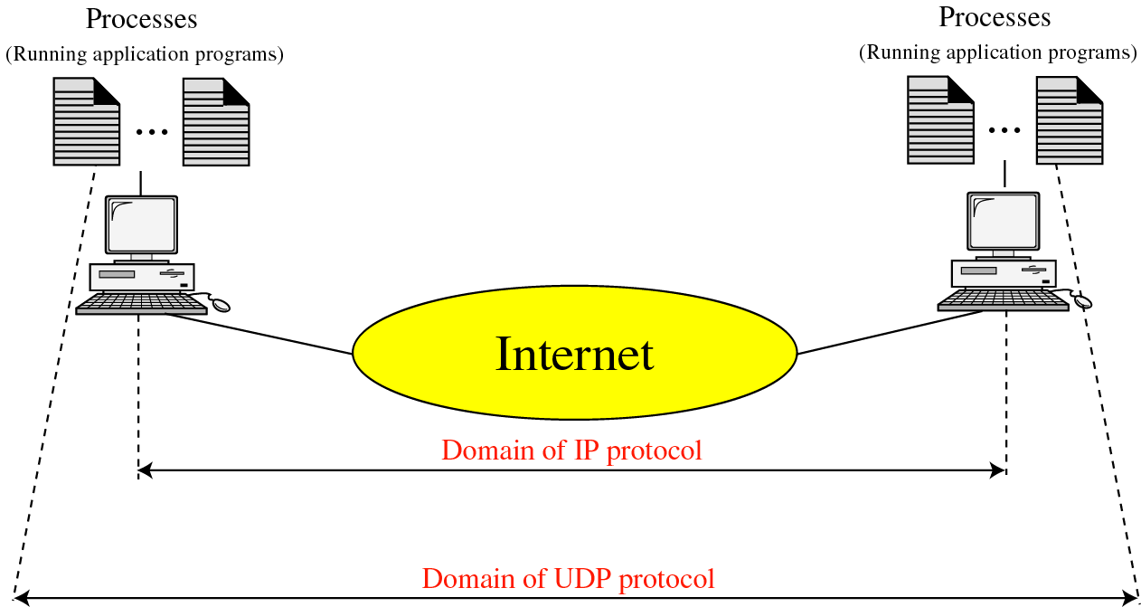
UDP (process-to-process) versus
IP(host-to-host)

Slide 5
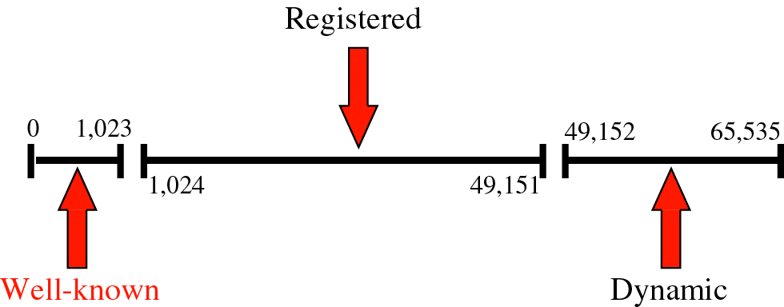
Port numbers & ICANN ranges

Slide 6
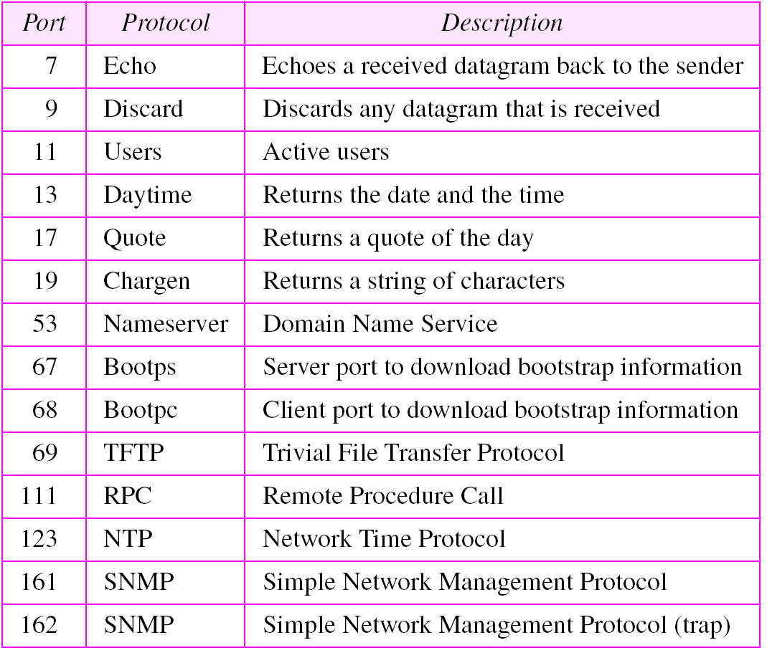
Well-known ports used with UDP

Slide 7
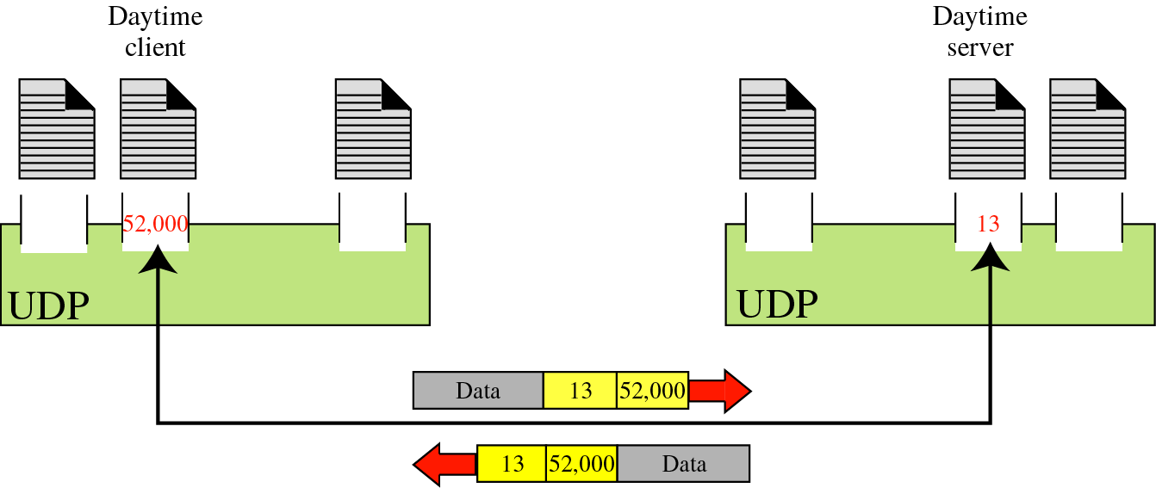
Port numbers

Slide 8
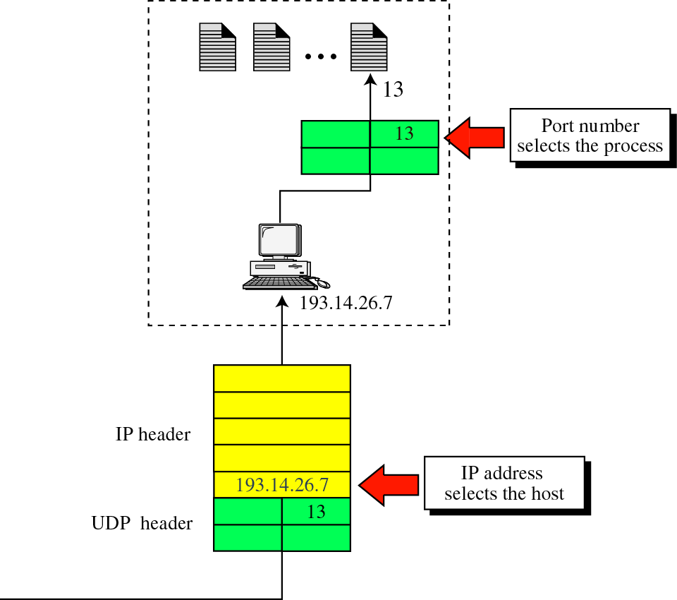
IP addresses versus port numbers

Slide 9
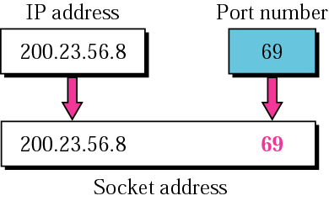
Socket address

Slide 10
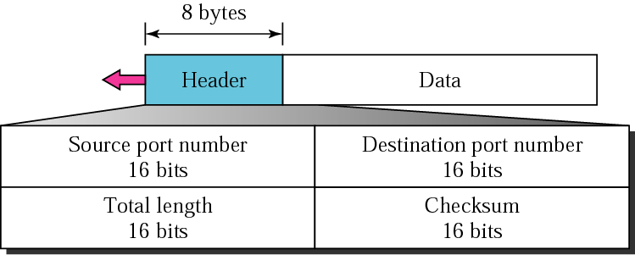
User datagram format

Slide 11
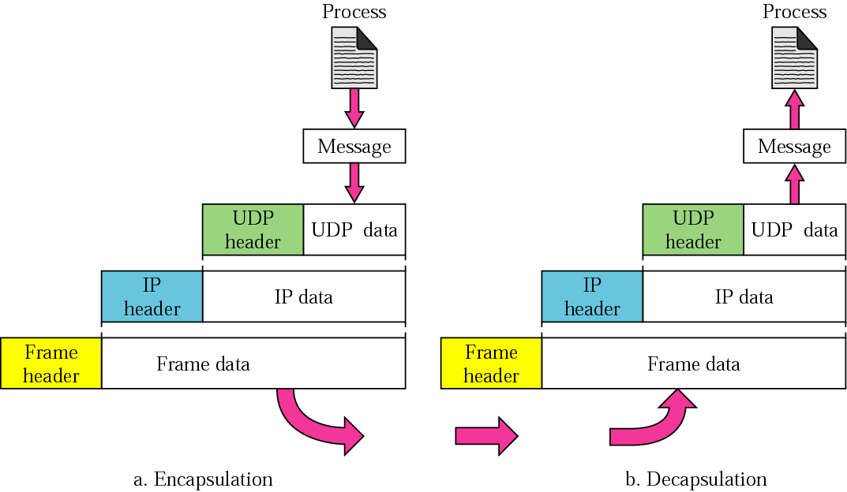
Encapsulation and Decapsulation

Slide 12
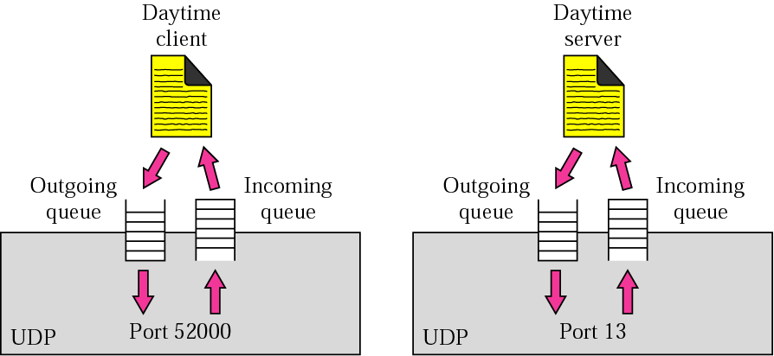
Queues in UDP

Slide 13
Transmission
Control Protocol
(TCP)

Slide 14
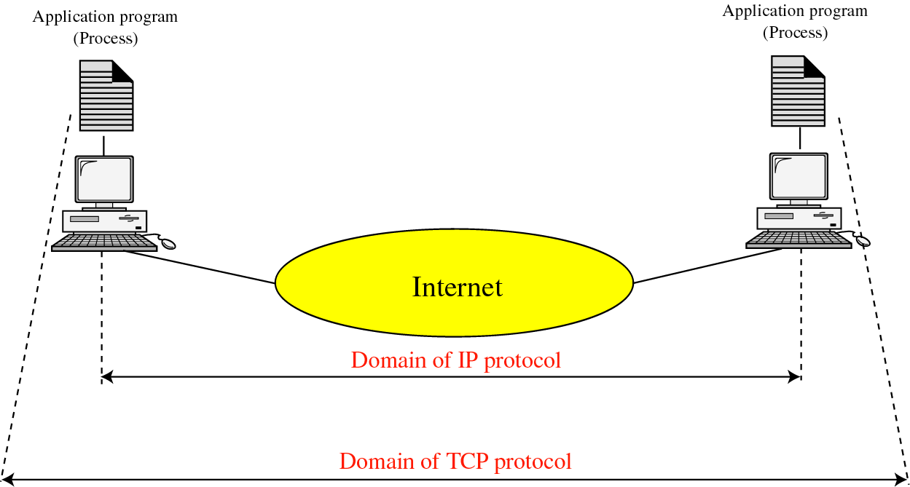
TCP versus IP

Slide 15
TCP SERVICES
Services offered by TCP to the processes at the application layer.
Process-to-Process Communication
Stream Delivery Service
Full-Duplex Communication
Connection-Oriented Service
Reliable Service

Slide 16
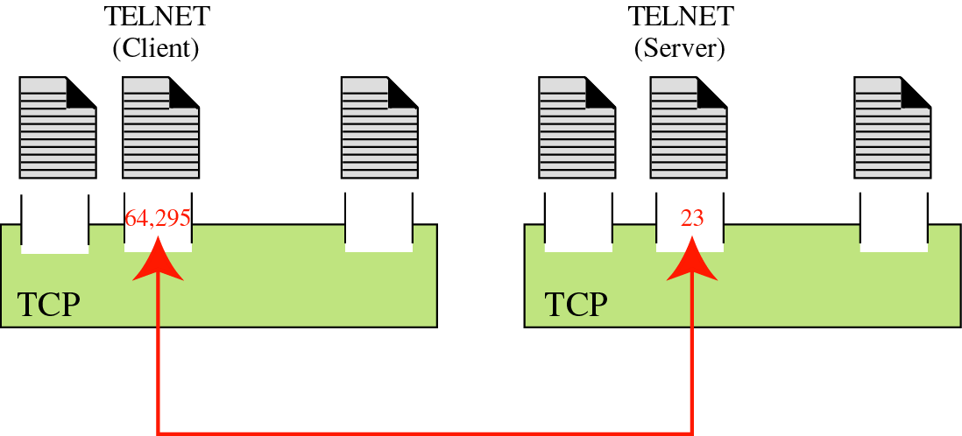
Port numbers

Slide 17
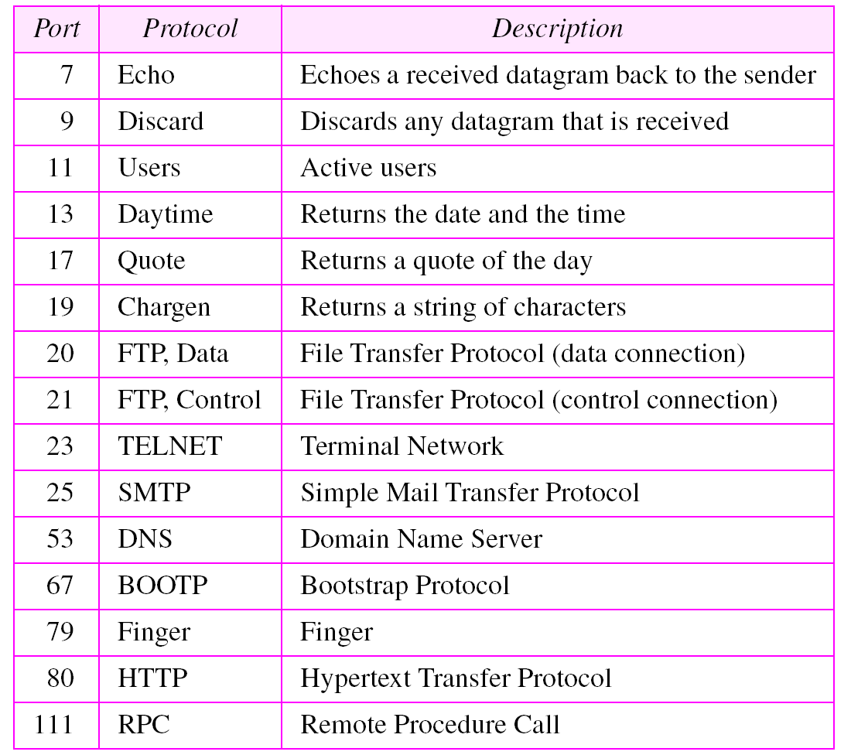
Well-known ports used by TCP

Slide 18
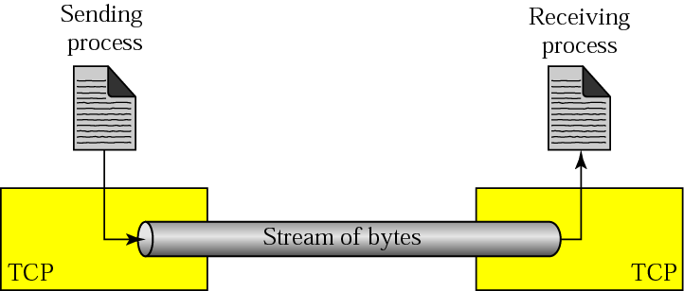
Stream delivery
TCP allows sending process to send and receiving process to receive data in a byte stream
TCP create an imaginary “tube”
Sending process produces (writes to) stream of bytes and receiving process consumes (reads from) them

Slide 19
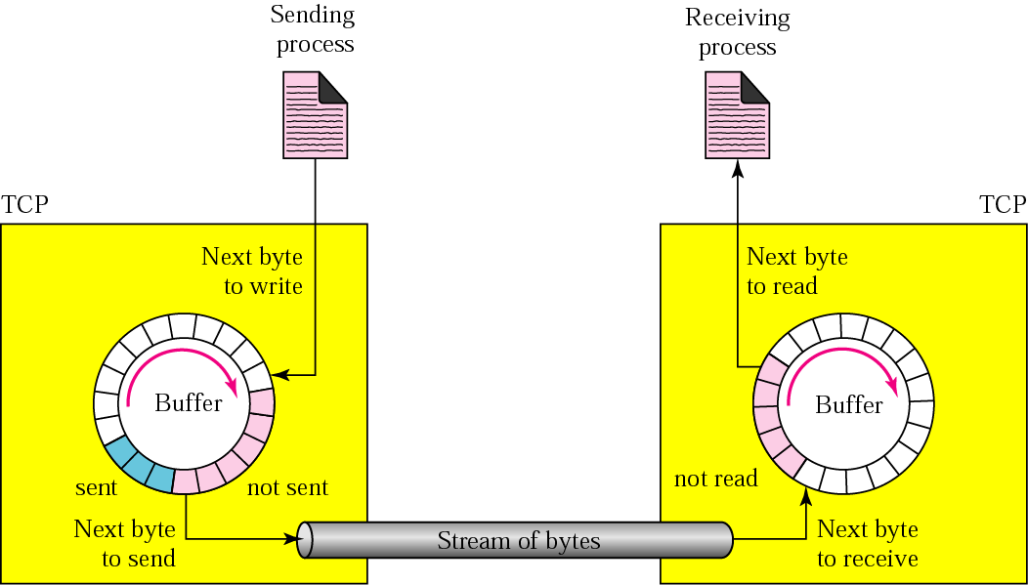
Sending and receiving buffers
TCP needs buffers because speed of producer & consumer may not same
These buffers are also necessary for flow- and error-control mechanisms
TCP keeps sent bytes until it receives an acknowledgement

Slide 20
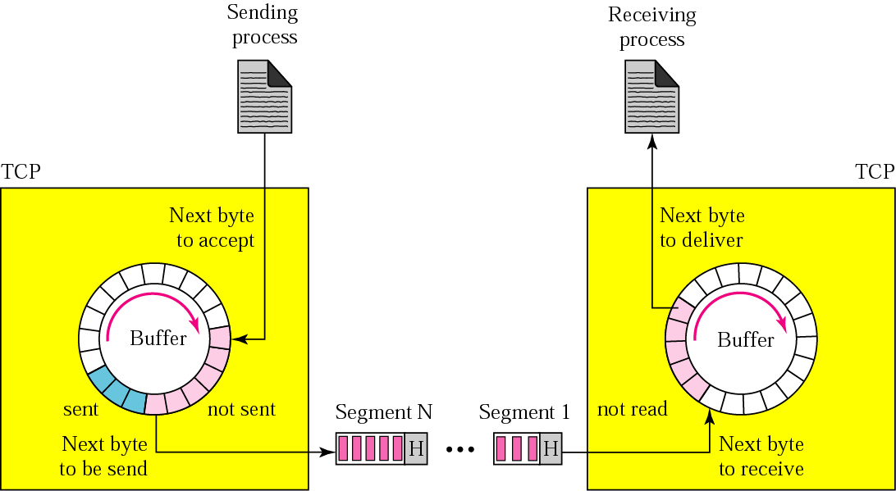
segments
TCP needs to send data in packets, not as a stream of bytes to IP
TCP groups number of bytes into a packet is called segment
segments are not necessarily of same size

Slide 21
Full duplex communication
Each TCP has both sending and receiving buffer
segments can move in both direction
Connection Oriented Service
Discuss later
Reliable Service
Discuss later

Slide 22
Numbering
Byte number
The bytes of data being transferred in each connection are numbered by TCP.
The numbering starts with a randomly generated number.
Sequence number
The value of sequence number field of a segment defines the number of the first data byte contained in that segment
Acknowledgement number
The value of acknowledgement field in a segment defines the number of the next byte a party expects to receive.

Slide 23
Imagine a TCP connection is transferring
a file of 6000 bytes. The first byte is
numbered 10010. What are the sequence
numbers for each segment if data is sent in five segments with the first four segments carrying 1,000 bytes and the last segment carrying 2,000 bytes?

Slide 24
Solution
The following shows the sequence number for each segment:
Segment 1 ➔ 10,010 (10,010 to 11,009)
Segment 2 ➔ 11,010 (11,010 to 12,009)
Segment 3 ➔ 12,010 (12,010 to 13,009)
Segment 4 ➔ 13,010 (13,010 to 14,009)
Segment 5 ➔ 14,010 (14,010 to 16,009)

Slide 25
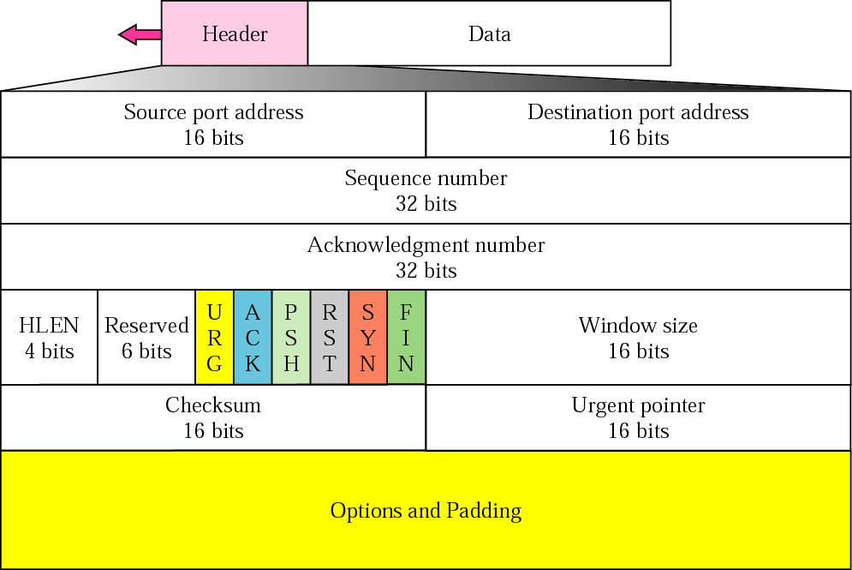
TCP segment format
20-60

Slide 26
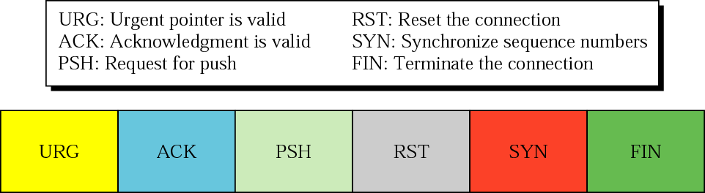
Control field

Slide 27
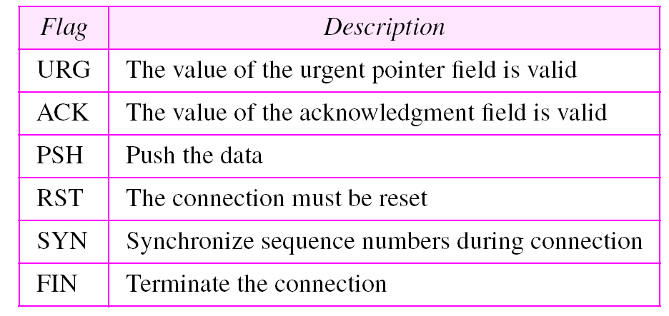
Description of flags in the control field

Slide 28
Note:
TCP connection is virtual, not physical.
TCP is connection oriented, which uses services of IP which is connection less.
Means IP is unaware of retransmission by TCP in case of segment lost or corrupted.
If segment arrives out of order, TCP holds it until missing segments arrive; IP is unaware of this reordering also

Slide 29
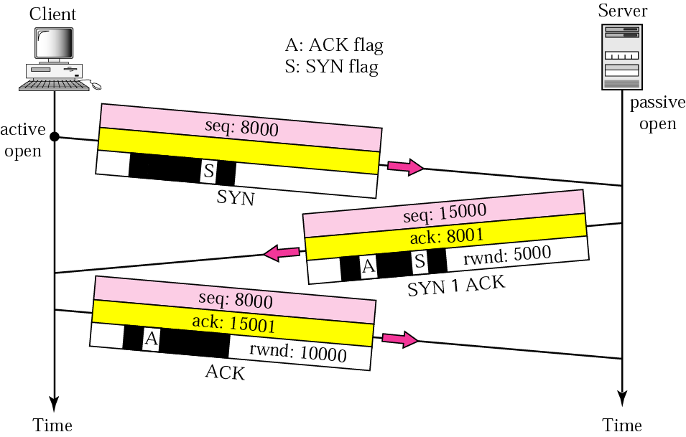
Connection establishment using three-way handshaking

Slide 30
Note:
A SYN segment cannot carry data, but it consumes one sequence number.
A SYN + ACK segment cannot carry data, but does consume one sequence number.
An ACK segment, if carrying no data, consumes no sequence number.

Slide 31
SYN flooding attack can be possible
It is a type of denial of service attack
Solution : limited connection request
Recent solution: postpone resource allocation until entire connection is set up using cookies. SCTP (Stream Control Transmission protocol), another transport layer protocol, uses this strategy.

Slide 32
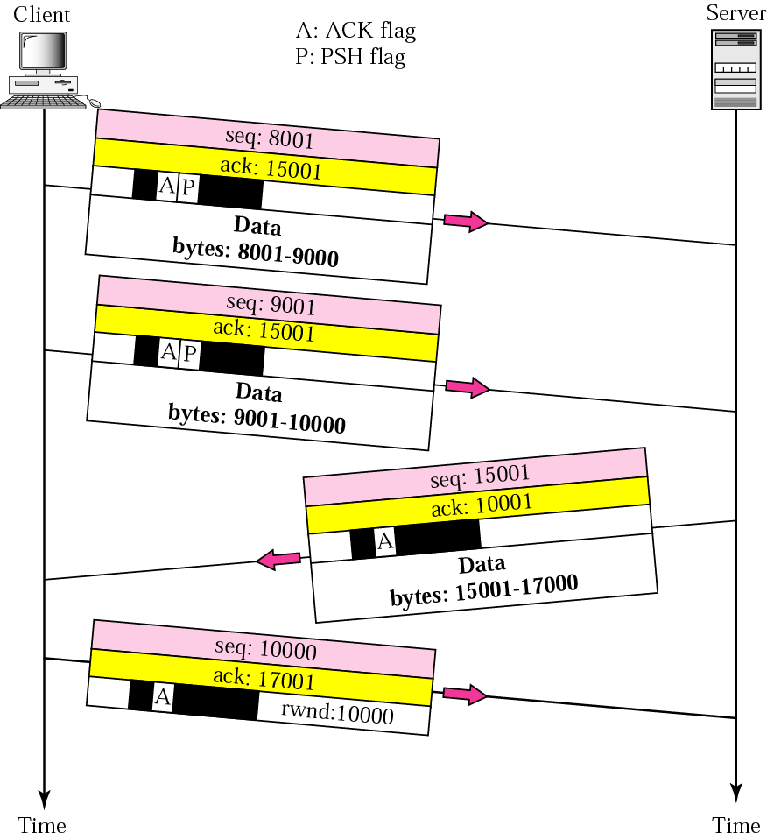
Data transfer

Slide 33
Push(PSH) bit set : deliver and receive as soon as possible without waiting for more data to send or come
Urgent(URG) bit set:
Sending TCP insert urgent data at the beginning of segment
Urgent pointer defines the end of urgent data and start of normal data
Receiving TCP extract the urgent data using urgent pointer and deliver it to application program immediately
Ex. Client issues abort command(Control + C) to stop the server to process further due to unwanted result

Slide 34
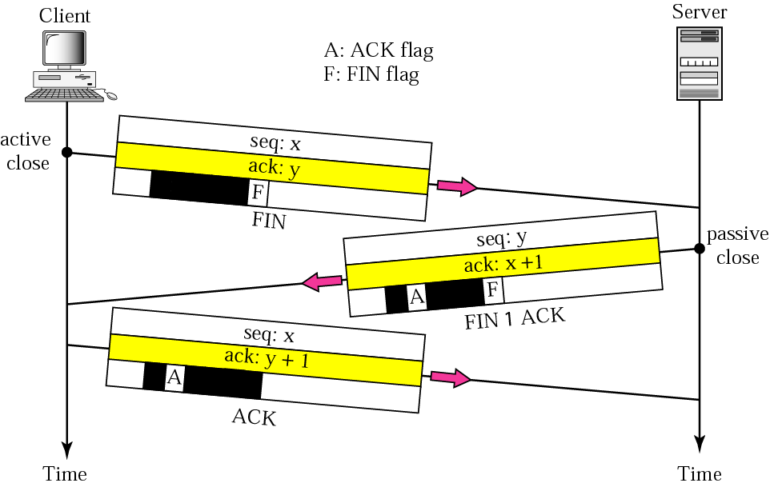
Connection termination using three-way handshaking

Slide 35
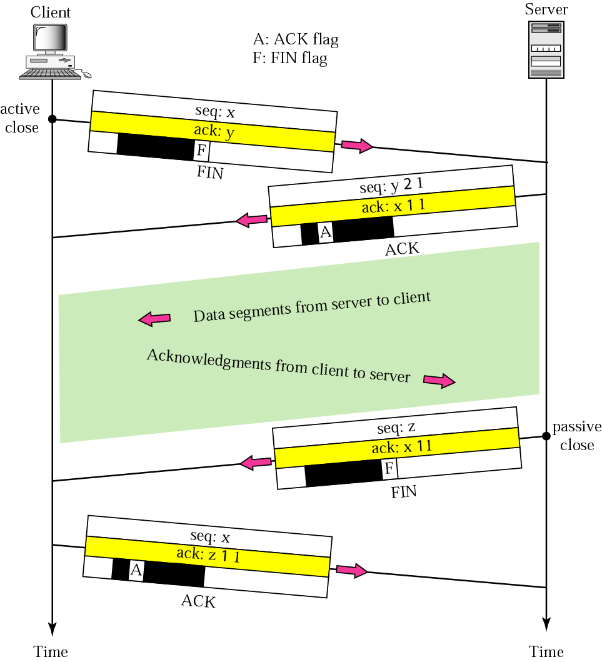
Connection termination using four-way handshaking with Half-close

Slide 36
Note:
RST flag can used for
Denying a connection
Aborting a connection
Terminating an Idle connection

Slide 37
FLOW CONTROL
Flow control regulates the amount of data a source can send. TCP defines a window that is imposed on the buffer of data delivered from the application program.
Sliding Window Protocol
Silly Window Syndrome

Slide 38
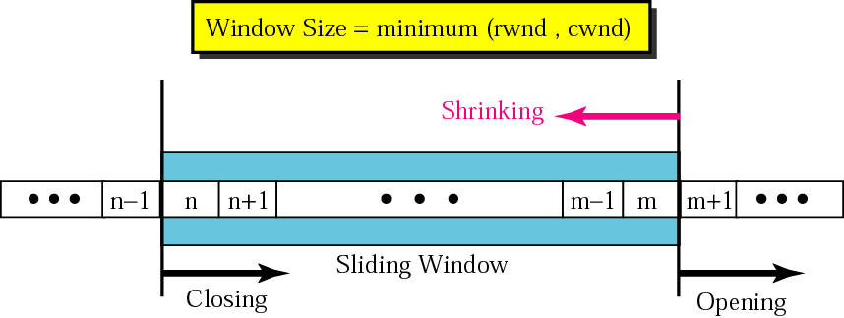
Sliding window
rwnd – receiver window
cwnd – congestion window

Slide 39
Note:
Window can be opened, closed or shrunk
Controlled by receiver (also depend on congestion in the network), not by sender

Slide 40
What is the value of rwnd for host A if the receiver, host B, has a buffer size of 5,000 bytes and 1,000 bytes of received and unprocessed data?

Slide 41
Solution
The value of rwnd = 5,000 − 1,000 = 4,000. Host B can receive only 4,000 bytes of data before overflowing its buffer. Host B advertises this value in its next segment to A.

Slide 42
What is the size of the window for host A if the value of rwnd is 3,000 bytes and the value of cwnd is 3,500 bytes?
Solution The size of the window is the smaller of rwnd and cwnd, which is 3,000 bytes.

Slide 43
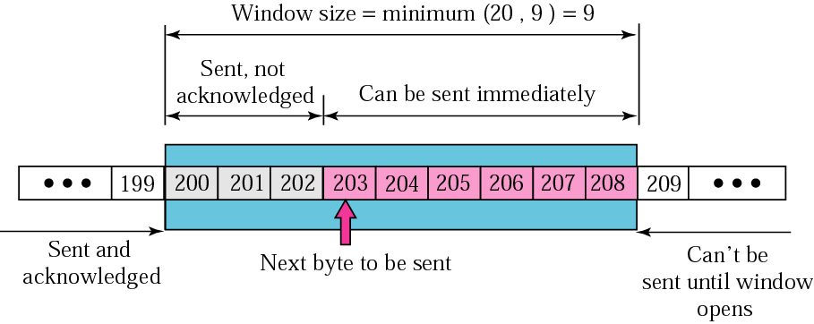
The sender has sent bytes up to 202. The receiver has sent an acknowledgment number of 200 with an rwnd of 9 bytes (in reality this value is thousands of bytes). We assume that cwnd is 20 (in reality this value is thousands of bytes). The size of the sender window is the minimum of rwnd and cwnd or 9 bytes. Bytes 200 to 202 are sent, but not acknowledged. Bytes 203 to 208 can be sent without worrying about acknowledgment. Bytes 209 and above cannot be sent.

Slide 44
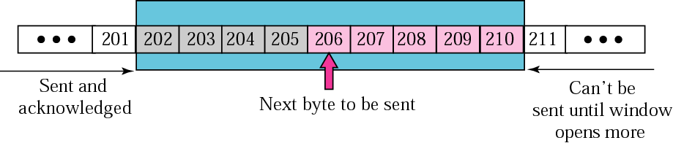
In previous figure the sender receives a packet with an acknowledgment value of 202 and an rwnd of 9. The host has already sent bytes 203, 204, and 205. The value of cwnd is still 20. Show the new window.
In above Figure the sender receives a packet with an acknowledgment value of 206 and an rwnd of 12. The host has not sent any new bytes. The value of cwnd is still 20. Show the new window.

Slide 45
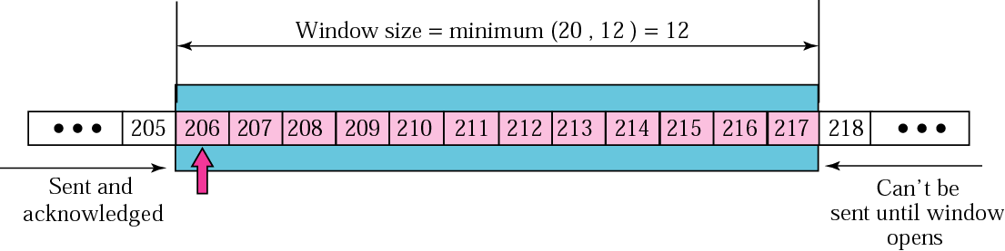
In above Figure the host receives a packet with an acknowledgment value of 210 and an rwnd of 5. The host has sent bytes 206, 207, 208, and 209. The value of cwnd is still 20. Show the new window.

Slide 46
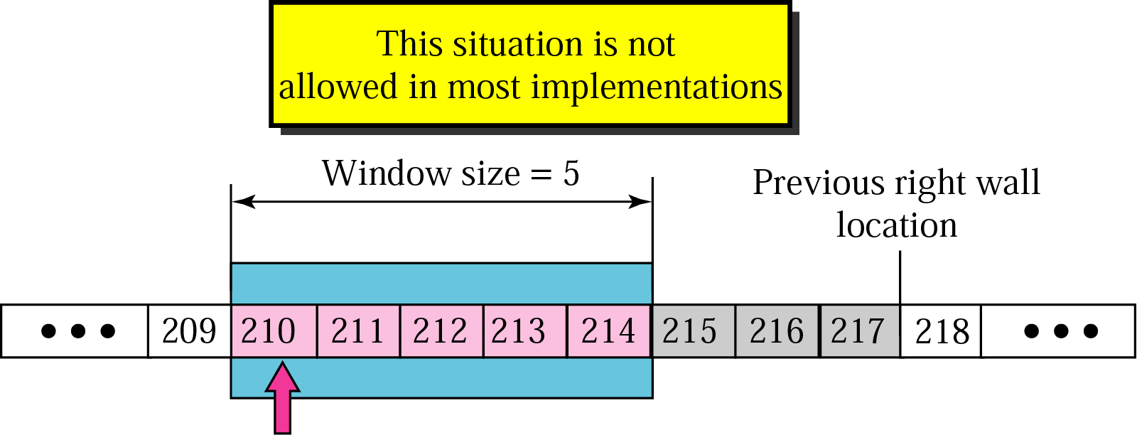

Slide 47
How can the receiver avoid shrinking the window ?
new ack + new rwnd ≥ last ack + last rwnd or new rwnd ≥ (last ack + last rwnd) − new ack

Slide 48
Window shutdown
When receiving TCP set rwnd to 0, sending TCP will shutdown the window
Sending TCP will not send any data until new advertisement has arrived from receiving TCP
Note: even when window is shutdown by an order from receiver, to prevent the deadlock the sender can always send a segment with one byte of data. This is called probing.

Slide 49
Silly Window syndrome
Happens when either sending application program produce data slowly or receiving program consumes data slowly or both.
Ex. TCP sending Segment of 1 byte. Overhead is 41/1. (20 TCP header + 20 IP header + 1 byte data)

Slide 50
Syndrome created by the sender
Previous example is a example of syndrome created by slow sender (producer)
Nagle’s Solution:
Sending TCP sends 1st segment even if it contains 1 byte data
Then wait for an acknowledgement or until enough data has accumulated

Slide 51
Syndrome created by the Receiver
Ex. Receiving application program consumes 1 byte at a time. It has a buffer space 4 kb. Sending application program produces data in blocks of 1kb. Buffer gets full after sender sends first 4 kb of data. Receiver will announce window shutdown. After consuming 1 byte, receiving TCP advertise rwnd of 1 byte. Eagerly waiting sender TCP will send 1 byte to receiver and this will continue for all bytes.
Inefficient use of network (41/1)
Clark’s solution: send an acknowledgement but with rwnd 0 until enough space is there in input buffer of receiver
Delayed Acknowledgement: do not send acknowledgement until decent amount of space is there in incoming buffer

Slide 52
ERROR CONTROL
TCP provides reliability using error control, which detects corrupted, lost, out-of-order, and duplicated segments. Error control in TCP is achieved through the use of the checksum, acknowledgment, and time-out.
Checksum
Acknowledgment
Acknowledgment Type
Accumulative Acknowledgement (do not report out of order or duplicate)
Selective Acknowledgement (reports out of order or duplicate. Does not replace ACK but as a option at the end of TCP)
Retransmission
Retransmission after RTO (retransmission time-out)
Retransmission after Three Duplicate ACK segments (fast retransmission)
Out-of-Order Segments
out-of-order results in retransmission
Some Scenarios

Slide 53
Note:
ACK segments do not consume sequence numbers and are not acknowledged.

Slide 54
Note:
The receiver TCP delivers only ordered data to the process.
Data may arrive out of order and be temporarily stored by the receiving TCP, but TCP guarantees that no out-of-order segment is delivered to the process.

Slide 55
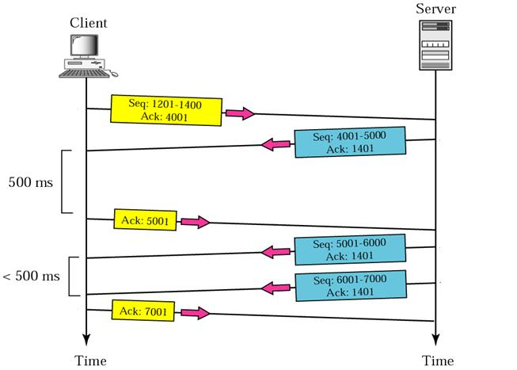
Normal Operation

Slide 56
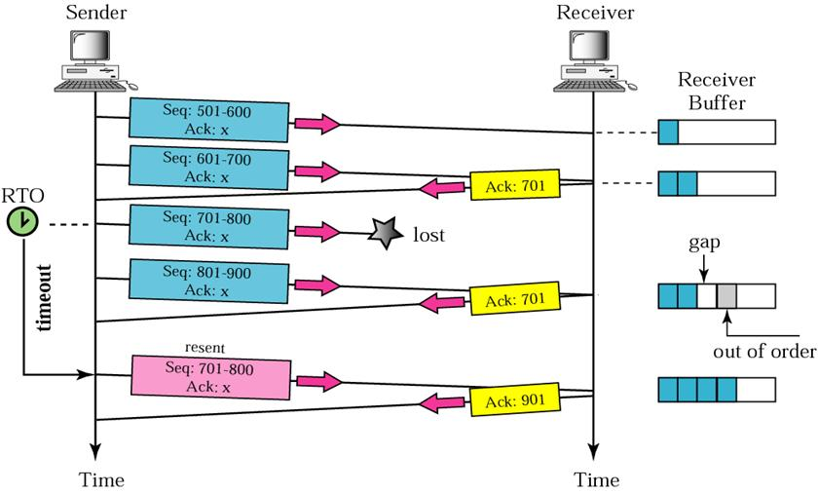
Lost segment

Slide 57
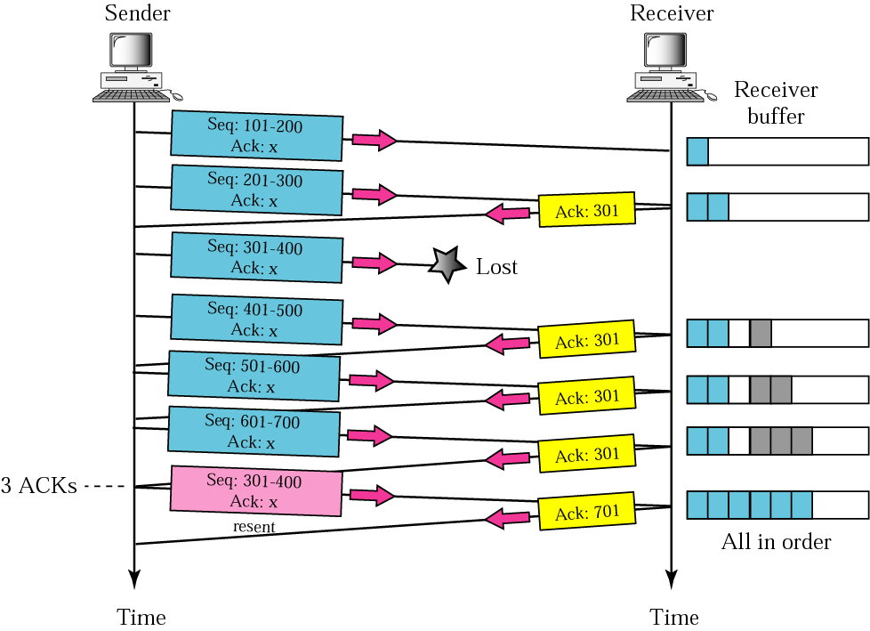
Fast retransmission

Slide 58
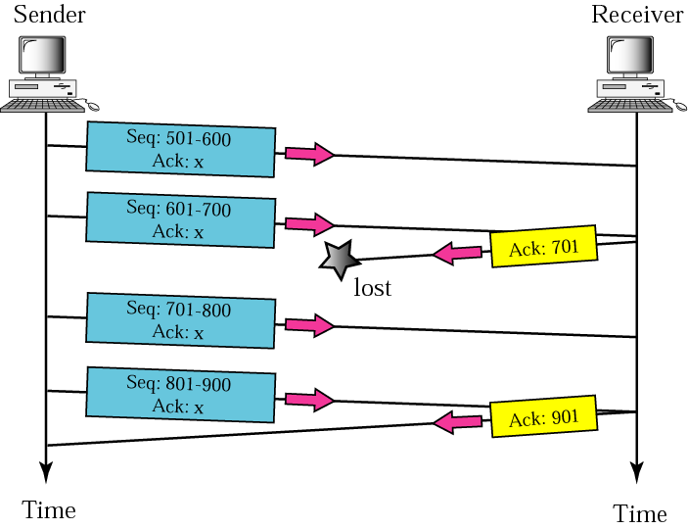
Lost acknowledgment Corrected Automatically

Slide 59
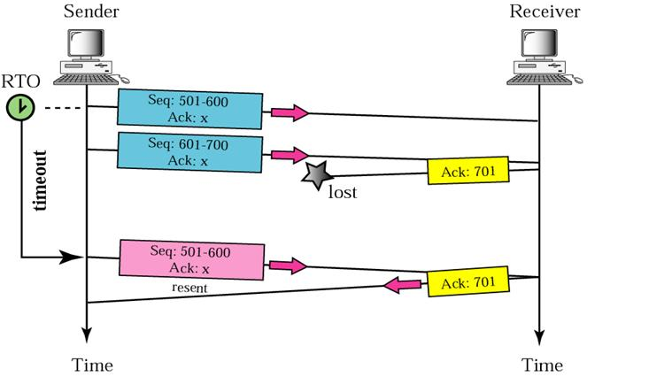
Lost acknowledgment corrected by resending a segment

Slide 60
Note:
Retransmission timer is set for data segment not for only Ack segment

Slide 61
Deadlock created by lost acknowledgement
Receiver sends Ack with rwnd set to 0
Sender is waiting for receiver to send Ack with rwnd set to nonzero value
After some time receiver sends Ack with rwnd set to nonzero value (receiver doesn’t have any data to send)
If this Ack gets lost then there will be deadlock
Sender is waiting for Ack with rwnd set to nonzero value from receiver and receiver is waiting for data from sender
Persistence timer is used to prevent deadlock

Slide 62
CONGESTION CONTROL
Congestion control refers to the mechanisms and techniques to keep the load below the capacity.
Network Performance
Congestion Control Mechanisms
Congestion Control in TCP

Slide 63
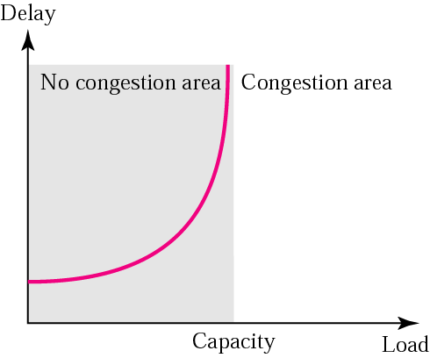
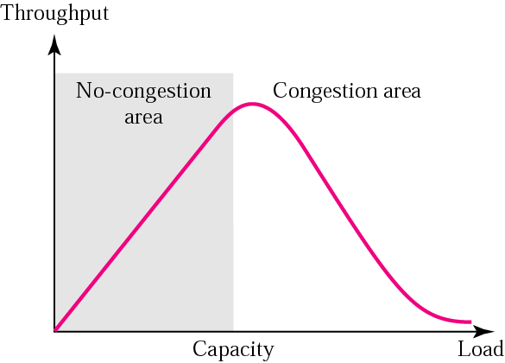
Packet delay Vs network load
Throughput Vs network load

Slide 64
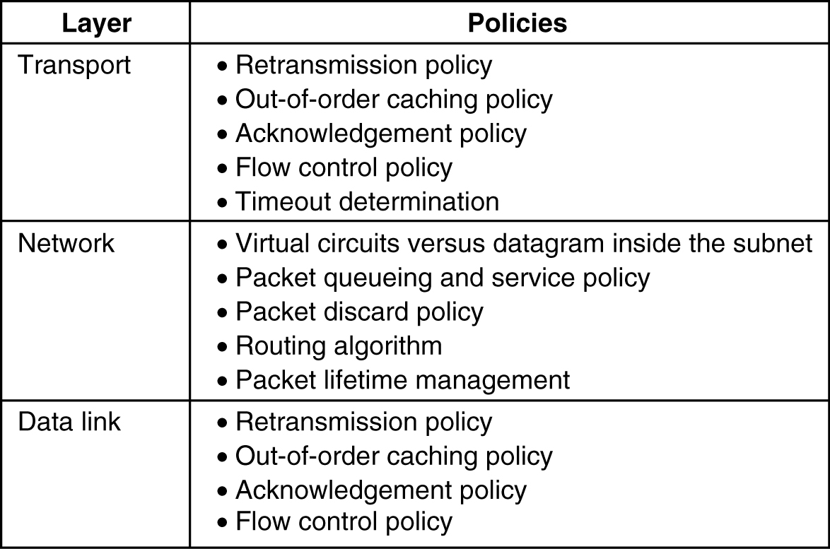
Congestion control mechanisms
Open-loop congestion control (prevention)
Choosing proper policy

Slide 65
Close-loop congestion control (detection and removal)
The warning bit
Choke packets
Hop-by-hop choke packets

Slide 66
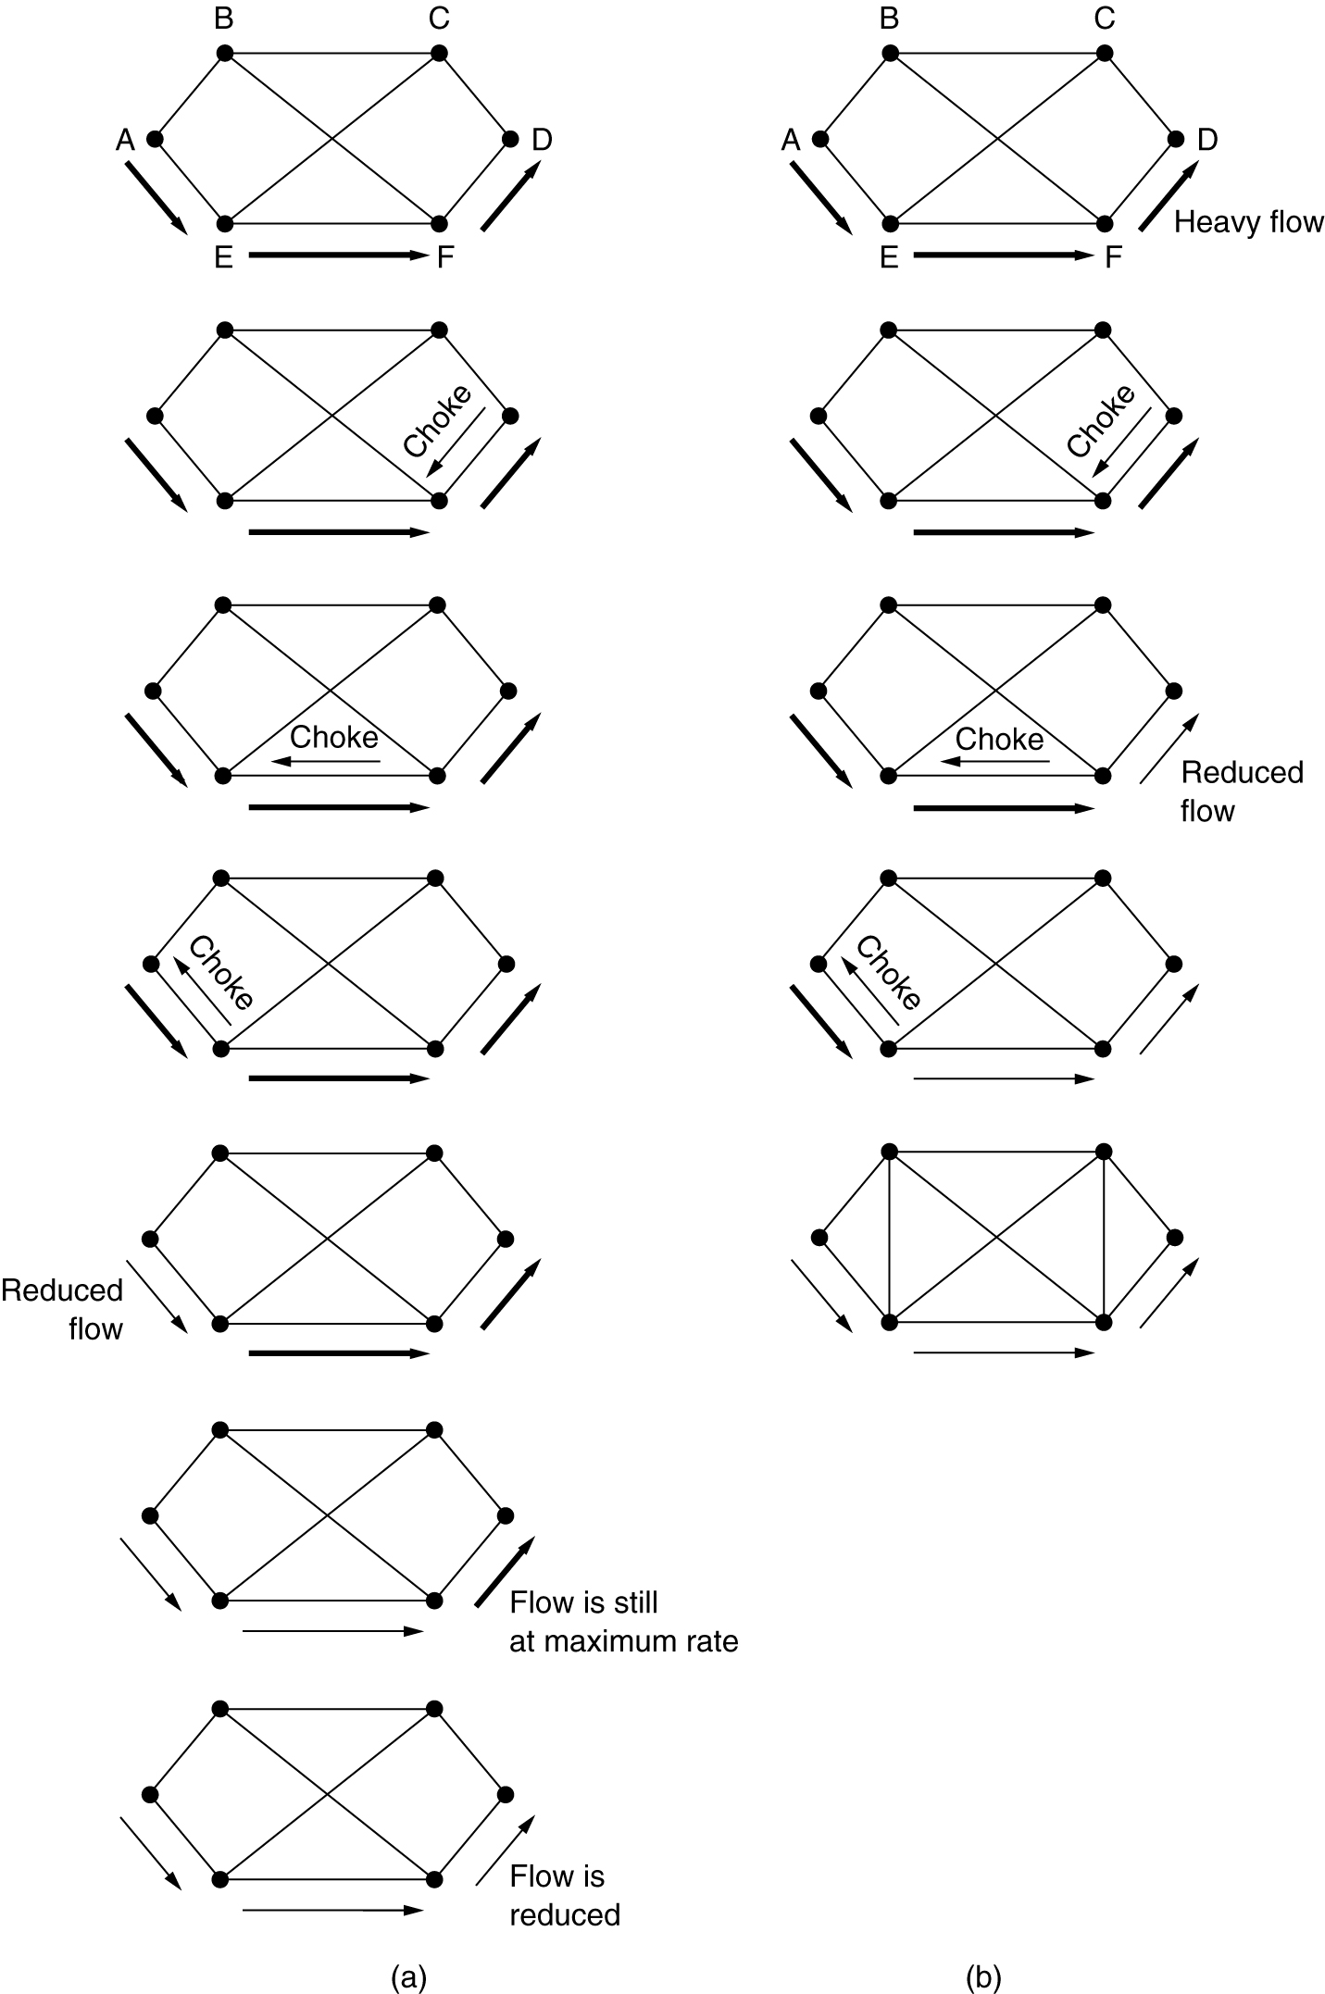
Choke Packets & Hop-by-Hop Choke Packets
(a) A choke packet that affects only the source.
(b) A choke packet that affects each hop it passes through.

Slide 67
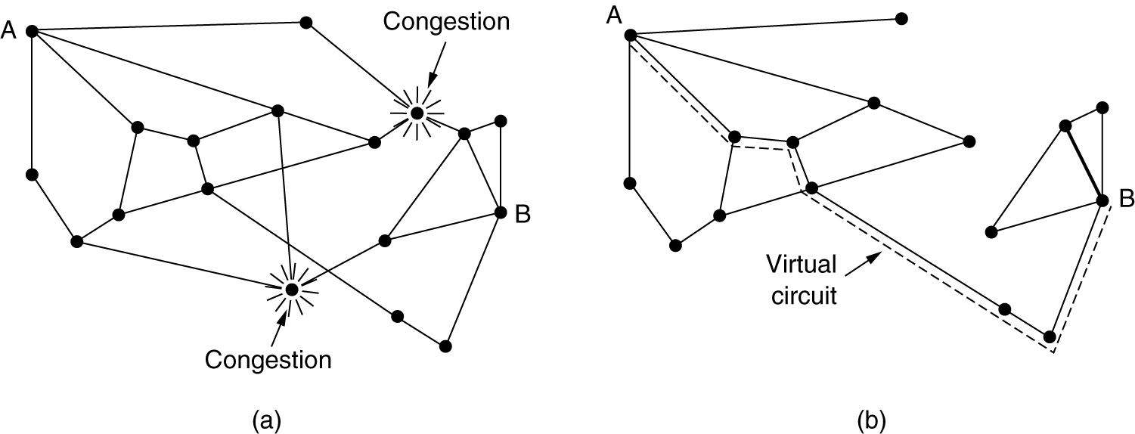
Congestion Control in Virtual-Circuit Subnets
(a) A congested subnet.
(b) A redrawn subnet, eliminates congestion and a virtual circuit from A to B.

Slide 68
Load Shedding
Two Policies
Wine (old is better than new)(wait-die)
Milk (new is better than old)(wound-wait)

Slide 69
Jitter Control
The variation in packet arrival times is called jitter
Ex. Variation in audio & video streaming
Solution1 : buffering data like video on demand
This will not work for real time data
Solution2: calculating transit time for each hop along the path and checking how much a packet is behind or ahead of its schedule

Slide 70
Congestion control in TCP
Three phases
Slow start: Exponential Increase
Congestion avoidance: additive Increase
Congestion detection: Multiplicative Decrease

Slide 71
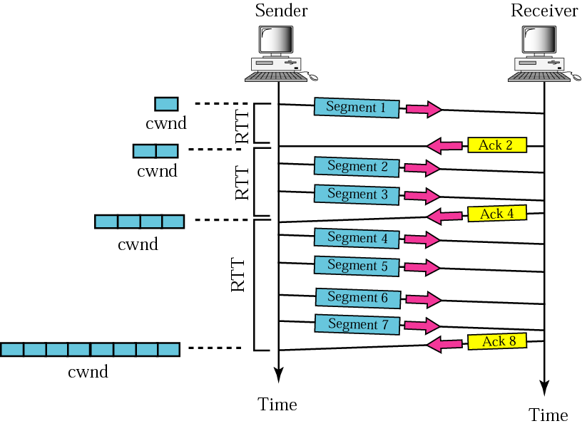
Slow start, exponential increase

Slide 72
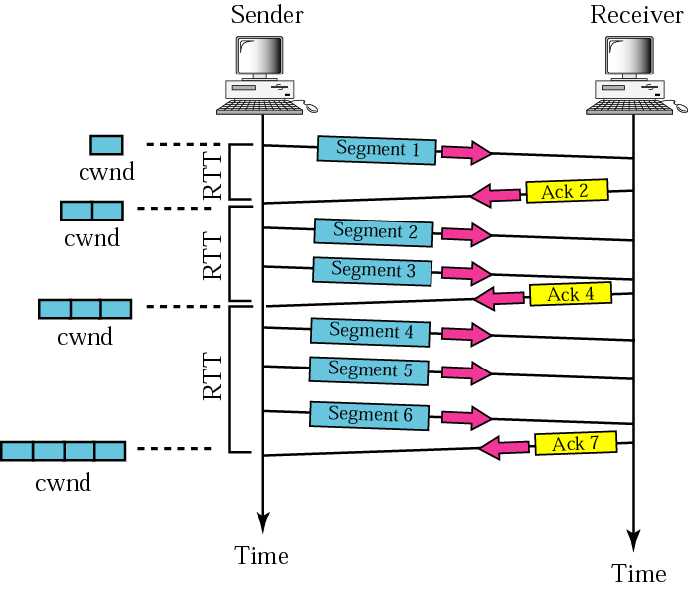
Congestion avoidance, additive increase

Slide 73
Congestion detection: Multiplicative Decrease
When congestion occurs, cwnd must be decreased
Sender can guess that congestion has occurred when it needs to retransmit a segment
Retransmission can occur in two cases:
RTO timer times out, a new slow start phase starts
Three ACKs are received, a new congestion avoidance phase starts

Slide 74
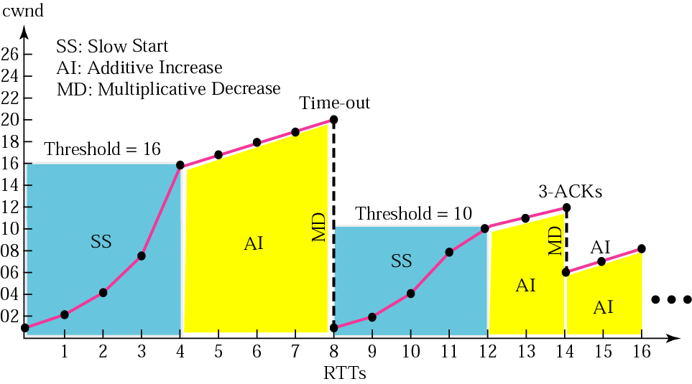

Slide 75
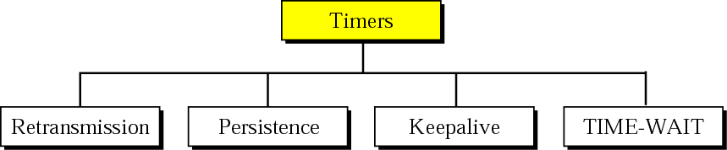
TCP TIMERS
To perform its operation smoothly, most TCP implementations use at least four timers.

Slide 76
Retransmission Timer
Used to retransmit a lost segment
Set to Round trip time
Persistence Timer
Used to avoid deadlock
Initially persistence timer is set to retransmission timer
When persistence timer goes off, sending TCP sends special segment called probe
Sender will continue doubling the value of persistence timer until it receives nonzero value of rwnd or persistence timer reaches to threshold (usually 60s).
After that it sends one probe segment every 60s.

Slide 77
Keepalive
Used to prevent long idle connection
What is client becomes silent after sending some data? How much time should connection be opened ?
Each time server hears from client, it resets this timer (usually 2 hours)
If server does not hear from client after 2 hours, it sends 10 probe segment, each of which 75s apart.
After that connection is being terminated.
Ex. IRCTC reservation, any online banking application

Slide 78
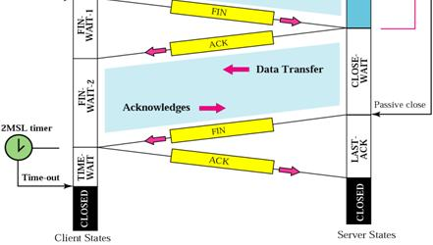
Time-Wait timer
Set to twice of max of segment lifetime in internet (between 30s to 1min)

Slide 79
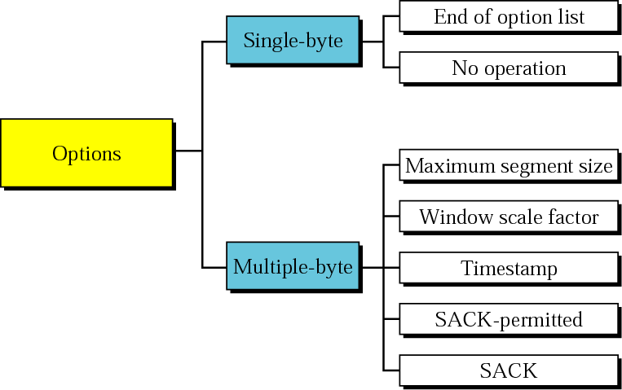
Options

